Slide 1
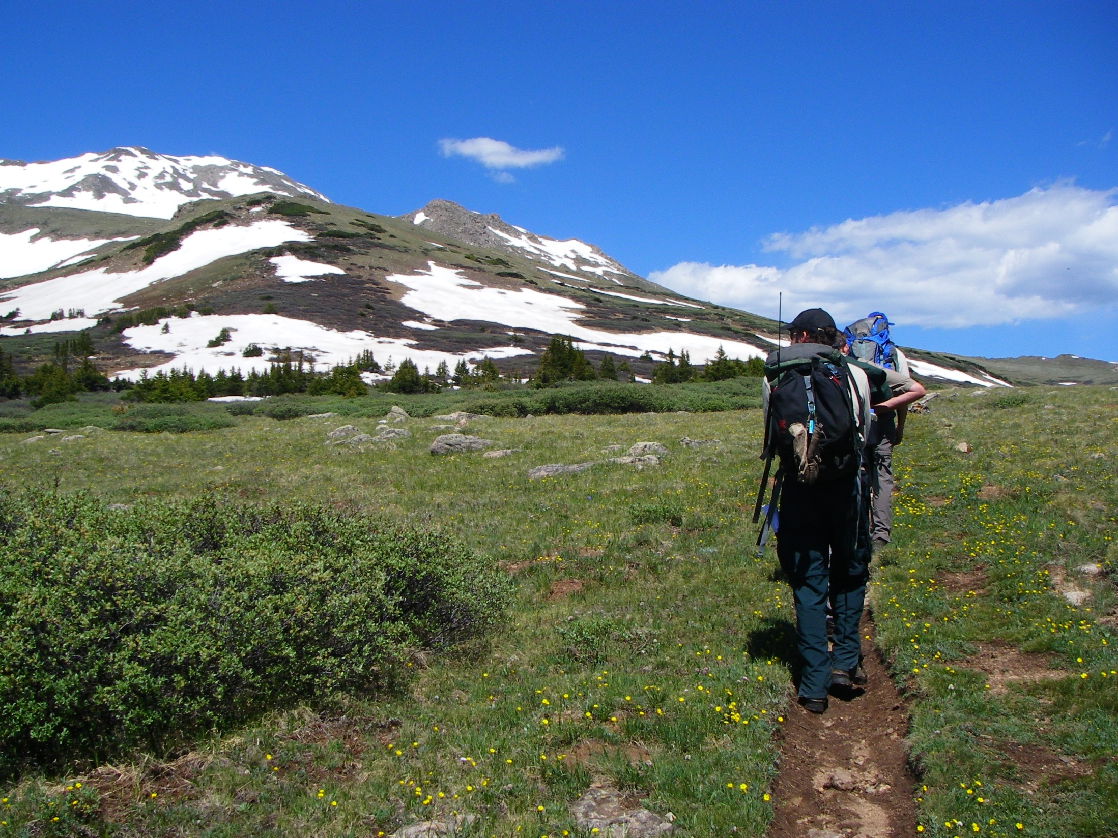
Alpine Ecology
Notes:
I think it is really important to understand the alpine when we talk to visitors about how they can do their part to take care of this harsh yet beautiful environment.

Slide 2
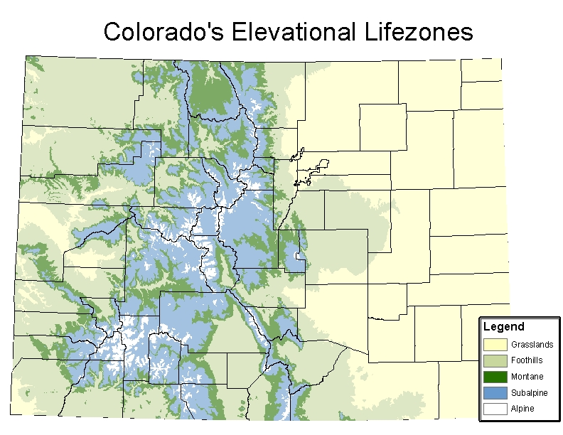
Notes:
Colorado’s Elevational Lifezones
Colorado is made up of essentially 5 lifezones, Can anyone name those five lifezones?
Grasslands (<5,600 ft asl) – sometimes broken into grasslands (Eastern Colorado) and semi-desert shrublands (Western Colorado)
Foothills(6,000-7,000 ft asl) – sometimes broken into
Pinon-Juniper Woodlands (P-J and Gamble Oak) in Western Colorado and
Foothill Forests (Ponderosa, Doug Fir, RM Juniper, Blue Spruce, Shrubs) in Eastern Colorado
Montane (6,000-9,000 ft asl) – ponderosa, Douglas fir, lodgepole, limber, aspen forests
Sub-Alpine (9,000-11,500 ft asl) – Englemann, Subalpine F, Bristlecone, Limber, Lodgepole
Alpine (11,500 – 14,433 ft asl)
Can anyone tell me which lifezone we in Leadville live in? (Sub-Alpine), Denver? (Grasslands & Foothills), Silverthorne? (montane).
What is Colorado’s highest point? What is that elevation?
What is Colorado’s lowest point? 3,315 ft a.s.l where the Arikaree River flows into the NW corner of Kansas. Lifezone?

Slide 3
Notes:
Colorado’s Elevational Lifezones
Colorado is made up of essentially 5 lifezones, Can anyone name those five lifezones?
Grasslands (<5,600 ft asl) – sometimes broken into grasslands (Eastern Colorado) and semi-desert shrublands (Western Colorado)
Foothills(6,000-7,000 ft asl) – sometimes broken into
Pinon-Juniper Woodlands (P-J and Gamble Oak) in Western Colorado and
Foothill Forests (Ponderosa, Doug Fir, RM Juniper, Blue Spruce, Shrubs) in Eastern Colorado
Montane (6,000-9,000 ft asl) – ponderosa, Douglas fir, lodgepole, limber, aspen forests
Sub-Alpine (9,000-11,500 ft asl) – Englemann, Subalpine F, Bristlecone, Limber, Lodgepole
Alpine (11,500 – 14,433 ft asl)
Can anyone tell me which lifezone we in Leadville live in? (Sub-Alpine), Denver? (Grasslands & Foothills), Silverthorne? (montane).
What is Colorado’s highest point? What is that elevation?
What is Colorado’s lowest point? 3,315 ft a.s.l where the Arikaree River flows into the NW corner of Kansas. Lifezone?

Slide 4
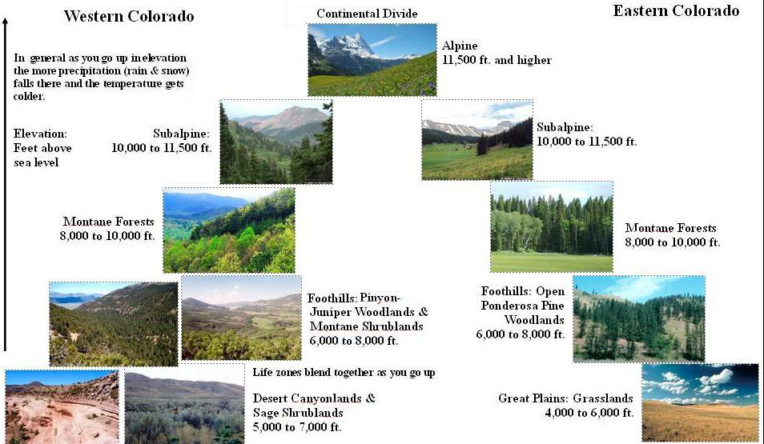
Notes:
Sometimes it is easier to look at pictures. You can see that Eastern & Western Colorado have different vegetation in the lifezones

Slide 5
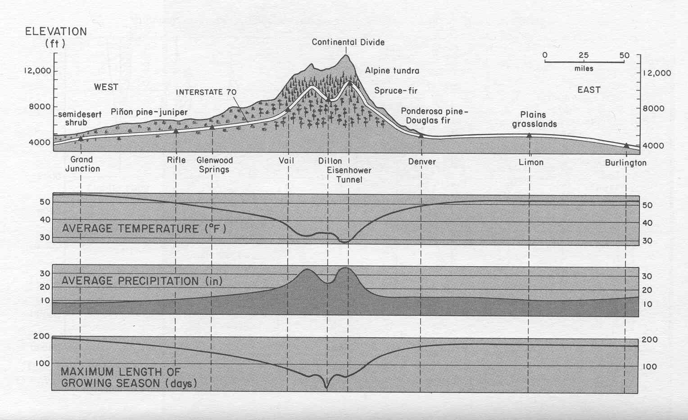
Colorado Climate by Elevation
Notes:
Colorado Climate by Elevation
With increased elevation:
Temperature decreases
precipitation increases
and the growing season is dramatically decreased.

Slide 6
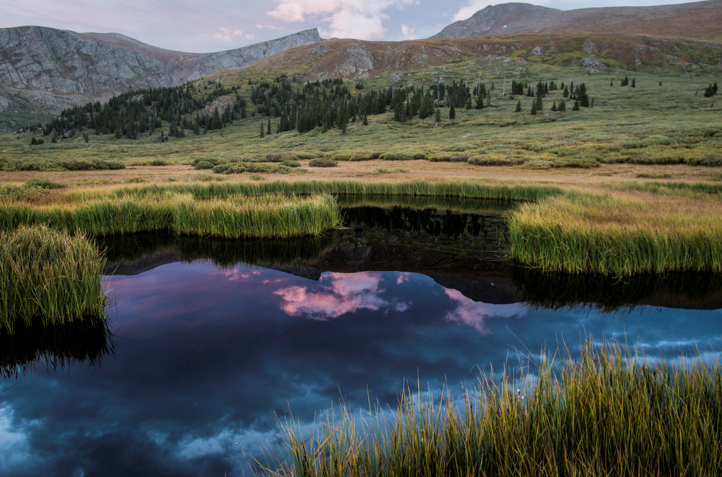
Alpine Tundra (>11,500 ft.)
Notes:
The Alpine Lifezone makes up ~ 3% of Colorado’s landmass. 1% of landmass of contiguous 48 states.
Nothing between you and the sky, no filtering haze, no dulling pollution, constant wind, breathless (less oxygen).
Land of contrast and incredible intensity: the sky is the size of forever and the flowers the size of a millisecond. There are no trees against which to measure one’s height. No houses or man-made mementos to give scale. The only objects larger than small are boulders, a strangely empty land.
There is no in-between in the alpine environment and for humans who live in an in-between-sized world, comprehension takes time.

Slide 7
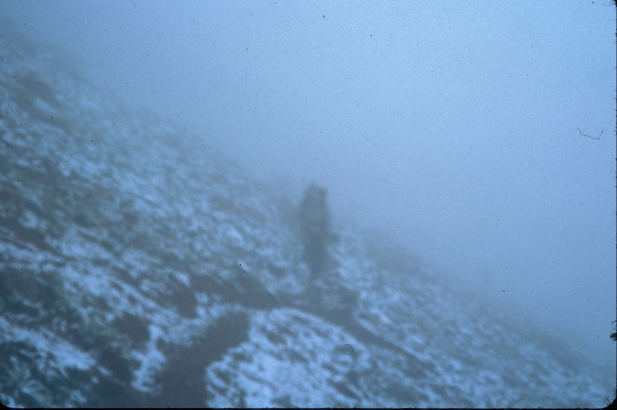
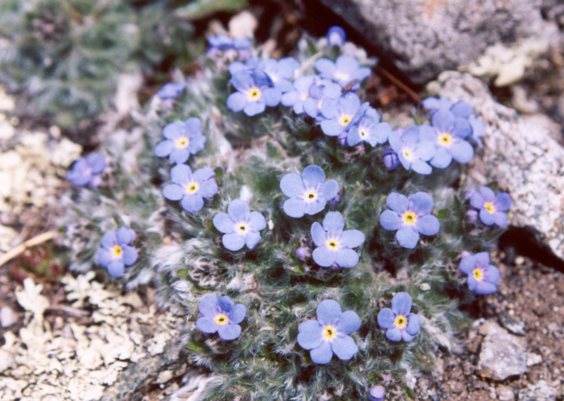
Harsh Reality
High Wind Environment
Low Effective Precipitation
U.V. Radiation (50% higher)
Temperature Extremes
Short Growing Season
Plant Adaptations
Chemical adaptations
Short stature
Preformation of buds
Perennial growth forms
Leaf & flower orientation
Dense pubescense
Notes:
The alpine ecosystem is beautiful but can be very harsh!
Wind, wind, wind. There is almost constant wind in the alpine.
Can anyone tell us the highest recorded wind speed? Alpine winds have been recorded at over 200 mph, with 74 mph gusts common.
Low effective precipitation. If you remember, from the climate at elevation slide, precipitation increases at altitude, why isn’t that precipitation effective?
Clues: majority of the precipitation comes in what form?
What happens when snow meets WIND?
Answer: Yes, most of the snow is blown off of the mountains into the trees.
There is twice as much ultraviolet radiation and 25% more light than at sea level. The clarity of light confuses one’s sense of scale. Faraway mountains are so sharp and clear that they seem much closer. This extreme wash of light and the intensity of the full light spectrum give you almost a sense of euphoria.
Temperature Extremes:
Can anyone guess how cold it gets in the alpine? Records show temperature as cold as 70 degrees below zero.
Combine this with a wind chill!! You could not have exposed skin at this temperature without instant frostbite.
With a temperature of -10 degrees F and a wind speed of 15 mph = Wind Chill -45 degrees F. With these temperatures exposed flesh can freeze in 60 seconds.
All of these factors lead to a significantly reduced growing season – typically 3 months or less
Adaptations of Flora & Fauna
Life survives at the outer and upper extremes of the alpine environment because it has been rigorously selected and adapted to the harsh conditions that surround it. The more severe the environmental conditions, the more pronounced are the adaptations for plant and animal survival. These adaptations are what we are going to talk about today.
Plant Adaptations
Chemical adaptations
Short stature
Preformation of buds
Perennial growth forms
Leaf & flower orientation
Dense pubescense

Slide 8
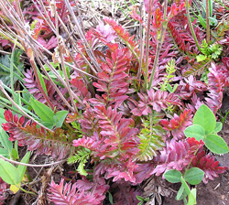
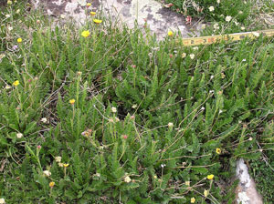
Chemical Adaptations
Anthocyanins-Alpine Avens
(Geum rossii)
Notes:
Chemical adaptations (Anthocyanins)
Large portion of alpine plants are marked with the distinctive red color of anthocyanin pigments in stems and leaves. (The same pigment that makes red apples red). Anthocyanin reds range from the red-purple of red cabbage to the orange red of poppies, the lavender of violets, and the blue of cornflowers, depending upon whether the plant’s sap is acid (red) or alkaline (blues). As we all know, plant pigments are always present, but are usually masked by greater amounts of green chlorophyll and are therefore only visible when the chlorophyll is reduced or absent. In most springtime alpine plants, the redness only appears in those cells exposed to light: A common plant in the alpine is the alpine aven with origami-folded leaves, when these leaves are spread open, they are green inside, but when released they assume their complex folding and only the red shows.
What do you think is happening? Why do you think this occurs? I think you will be amazed by this adaptation.
Clue: The redness (presence of anthocyanins) is most pronounced in the spring and fall, before and after photosynthesis is fully operative in the leaves.
Answer: The Anthocyanins, abundant in spring, are a product of carbohydrates stored in the roots from the previous growing season. When rapid growth begins in early spring, part of the carbohydrate is incorporated into new plant tissue, part into anthocyanins.
Here is the real mindblower – Anthocyanins are capable of converting incidental light rays into heat to warm the plant tissues, very important in the chilly temperatures of an alpine spring. Those plants which have an abundance of anthocyanins endure cold better than greener plants, and anthocyanin production is an important factor in cold-hardiness, an essential adaptation at high altitudes.
In the fall before the leaves fall off and the plant closes up shop, it wants to pull in as much sugar and nutrients as possible from its leaves, which is where the anthocyanin comes in.
The prevailing theory is that anthocyanins protect the leaves from excess sunlight and enable the plants to recover any last remaining nutrients. The reason you'll see more vibrant reds during some years is that lots of sunlight and dry weather increase the sugar concentration in the plants vascular fluid, triggering the plant to release more anthocyanins in a last-ditch effort to gather up energy to get through the winter.

Slide 9
Dwarfism
Crepis nana (dwarf hawksbeard) between Mt. Lincoln and Mt. Bross.
Notes:
Short Stature (Dwarfism):
Almost all alpine plants are tiny in size. We often say that the best way to enjoy the alpine plants is to lie on your belly. This is a good way to view the tiny plants.
Why else would lying on the ground make viewing of alpine plants more enjoyable?
Clue: What other environmental aspect is less close to the ground.
Answer: Wind speed and pressure increases with height above the ground so the environment is colder and windier at a person’s height than at plant height. Less wind, more radiation = warmer!!

Slide 10
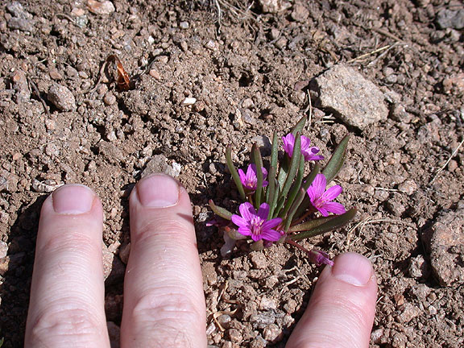
Dwarfism (small stature)
Pygmy Bitterroot
Notes:
Short Stature (Dwarfism):
This small size is advantageous in that it keeps them both snugged low to the ground; out of the worst of the alpine weather and requires less energy for the production of plant tissue so that more energy can be utilized for seed development. This dwarfing typically involves only the growth shoots (or the green part of the plant) making the flowers seem larger in proportion.

Slide 11
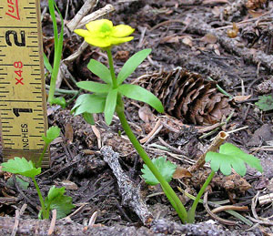
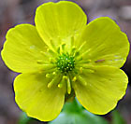
Preformation of Buds
Snowbed buttercup (Ranunculus eschscholtzii)
Notes:
Preformation of buds:
Flower buds of alpine plants are often begun early in the previous year’s growing season, (sometimes several years before) and are usually well-formed by the end of the summer so that they are safely protected before the winter sets in. Studies on an alpine buttercup pinpointed a cell that eventually gave rise to the yellow flower: it formed the first year, divided many times during the second growing season, formed a bud during the third, and eventually bloomed in the fourth summer.
Why would this be an advantage to alpine plants?
Clue: preformation of buds means that the buds are standing at ready to burst forward at the first sign of warming temperatures.
Answer: The growth of the plant, as well as the setting and ripening of seeds require the warmth of summers, but with the preset bud formation, the flowering does not require the full warmth of summer. This allows the maximum time to ensure that the seeds have plenty of time to ripen thus protecting plant reproduction.
Early growth is also made possible because of the large amounts of starches and sugars stored as carbohydrates in below-ground parts during the previous summer’s growing season. Alpine plants are a little like icebergs – a tiny percentage of the plant is above the ground, much like the small percentage of icebergs that show above the surface of the ocean. Some cushion plants that are 4” in diameter are 40 years old and have a 6 foot tap root. The root not only stores the abundant carbohydrate, but also probes for deep water sources and anchors the plant against the constant winds. You know the saying “the tip of the iceberg” let’s put that in the alpine environment and we could say “the tip of the alpine plant” or “the tip of the forget-me-not”.
When the plant is dormant during the winter’s low temperatures, the reserve of starches and sugars are not reduced. As temperatures warm in spring, the accumulated carbohydrates are converted for rapid growth. During this period, the plant is using its food faster than it can be made through photosynthesis and the carbohydrates stores are depleted. Many plants may even grow at a deficit until its growth is about 75-90% complete for the season, then plant growth or expansion slows and the stores are replenished. By the onset of dormancy in the fall, the underground carbohydrates are back up to the highest level of the year.
Should this fact give us a clue as to the best times of the year to transplant alpine plants for revegetation purposes?
When would be the best time or times to transplant alpine plants? Why?
Answer: During the spring and fall when the roots contain substantial carbohydrate stores to help the plant establish itself and fight the stress of being moved, and being exposed to the elements (even briefly).

Slide 12
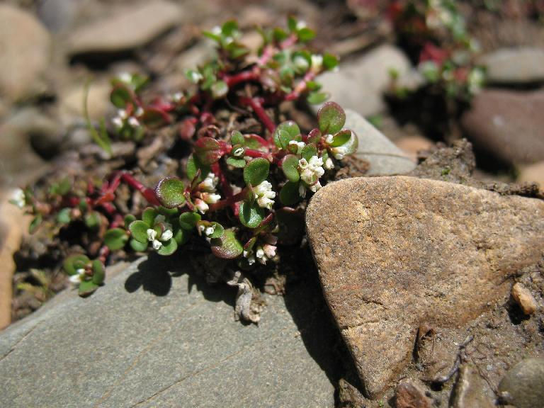
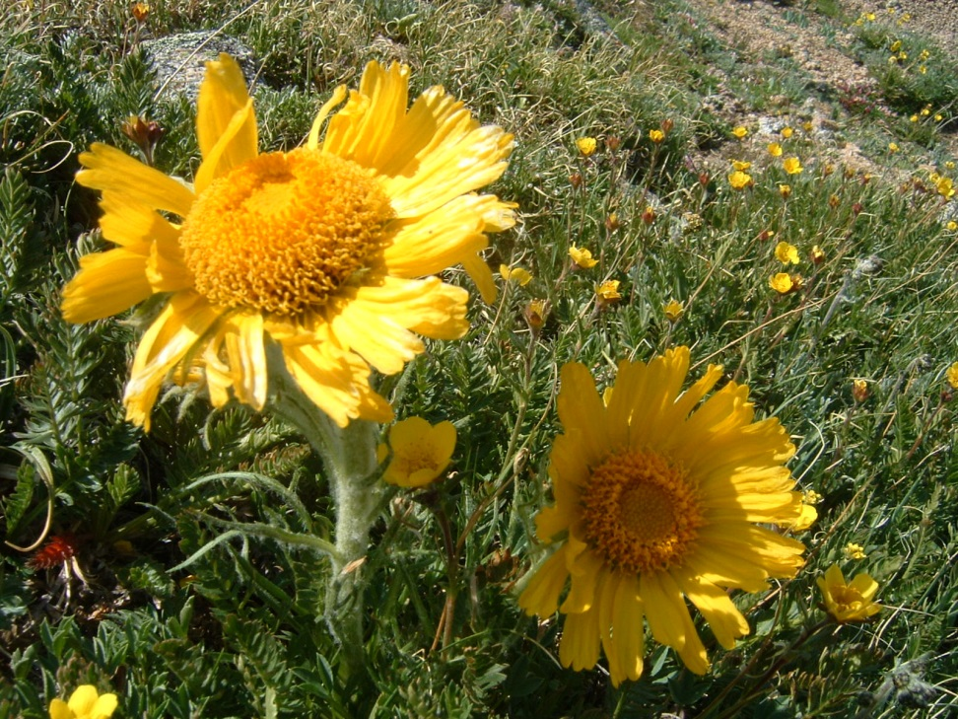
Annual vs. Perennial
Koenigia islandica – one of the few true alpine annuals
Old-man-of-the-mountains (Hymenoxys grandiflora)
Photo By Susan Kelly
Notes:
Koenigia G4/S2 Secure Globally, Imperiled in state – 6. occurrences recorded in Wyoming, 15 in Colorado, 4 in Montana
Perennial Growth Forms:
Most alpine plants are perennial.
Can anyone tell me the difference between a perennial plant and an annual plant?
Answer:
A perennial plant lives more than two years.
An annual plant germinates, flowers and dies in one year.
Why would it be advantageous for alpine plants to be perennial?
Answer: Again, short growing season. Would be very difficult for a plant seed to germinate, produce stems, leaves, flowers and produce seeds for a new crop of plants within a single growing season. It puts annual plants at a significant disadvantage when completing for nutrients, space and water!! Especially considering drought cycles.
A perennial plant can just add to what is already established, depends on a stable root system and is able to survive without flowering if the season is particularly bad (like in 2001!). In the alpine some plants, like an old-man-of-the-mountains, are ten to fifteen years old before they ever flower. The old man of the mountain typically spends its first 6-8 years of life producing only leaves and storing reserves in its thick underground root. When enough carbohydrate accumulates, floral buds develop & the following year the plant blooms, seeds mature, and the plant dies. Unlike sunflowers at lower elevations (annuals), the alpine sunflower compensates for the short, cold winters by being a long-lived perennial.

Slide 13
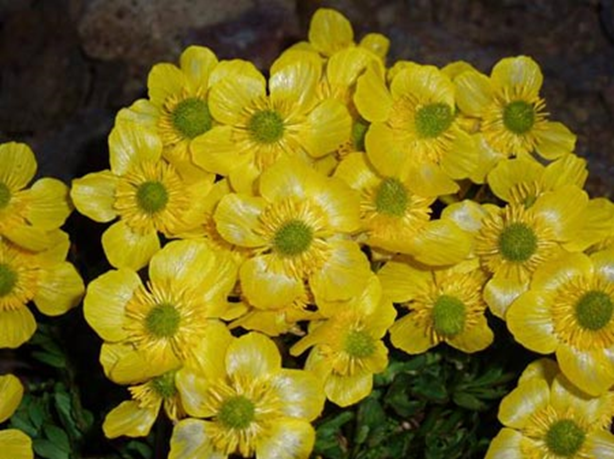
Ultraviolet Radiation
Notes:
Another way the alpine buttercup improves its chances of survival is by using the intense ultraviolet radiation available in the alpine to it’s advantage.
What strategy do you think this amazing little plant is using?
The production of viable seeds requires heat. Can you see how shiny it’s petals are?
This amazing plant uses its shiny petals to reflect sunlight onto the developing seeds and can raise the internal temperature of it’s flower 12-14 degrees.
This also attracts pollinators who seek the warmth.

Slide 14
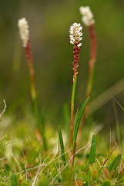
Live Birth
Bistorta vivipara
Notes:
Viviparous bistort has the potential to reproduce in two different ways. These plants form vegetative bulbils along its spike and white flowers at its tip. Although the flowers have the potential for producing seeds, viable seeds of this plant have never been reported in the Rocky Mountains. Instead, the bulbils drop from the parent plant and establish themselves immediately, sometimes sprouting before they are even shed by the parent plant. These plants essentially give live birth.

Slide 15
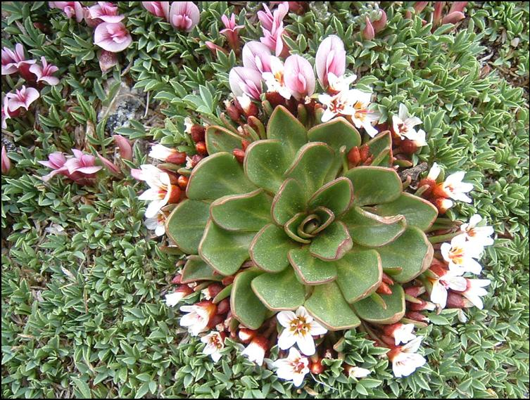
Leaf and Flower Orientation
Big-Rooted Springbeauty (Claytonia megarhiza)
Notes:
Leaf and flower orientation
There are whole habitats that exist in the alpine environment known as cushion plant communities. These plants are the perfect example of leaf and flower adaptations in alpine plants. These small low growing mats allow the wind to flow over them much as wind over an airplane wing. At the same time, there is maximal exposure of leaf surface for photosynthesis. Temperatures are often several degrees higher on the inside of a cushion plant than on the outside, the colder it is outside, the greater the difference. The outer parts of the cushion slows the impact of the wind on the inner part and reduces its drying effect. The tightly packed branches also cause the plant to catch blown in dirt which together with old leaves, absorbs moisture and contributes to soil building and stabilization.
Radial Symmetry or “rosette growth” like the deep rooted spring beauty may be even less exposed to desiccating winds than a cushion since it may be flatter to the ground. It grows in the warmer air at the soil’s surface, receiving direct sunlight as well as reflected heat from beneath. There is little or no vertical separation between the leaves, thus a happy balance is attained between the greatest exposure to light and the least exposure to cold, wind damage and drying. Water coming from the roots has the shortest possible distance to travel to the leaf tips.
Radial Symmetry is also especially efficient for plants whose moisture, lights and nutrients come from all directions. In the alpine, there are no trees or large shrubs to shade or to usurp soil moisture.
Succulence, combined with a rosette form, provides even greater protection against high altitude desiccation. This deep rooted spring beauty’s leaves are also coated with a waxy surface preventing evaporation of precious moisture. In addition, the leaves of the plant have a profusion of interior cells filled with a slightly mucilaginous sap, unlike the watery sap of most plants.
Can you tell me other types of plants that are succulent?
Clue: the sap of this plant is often used as a topical ointment for burns, cuts and abrasions.
Answer: Cactus and cactus like plants including Jade, Aloe Vera, etc.

Slide 16
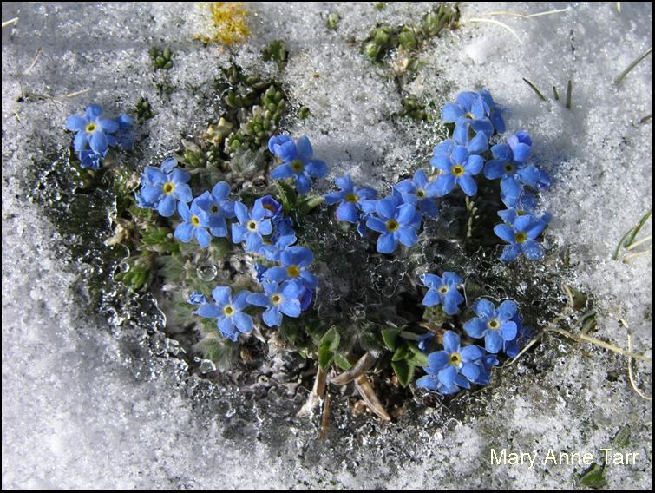
Pubescense
Alpine Forget-me-not (Eritricnum nanum)
Notes:
Pubescence:
This alpine forget-me-not is a good example of an alpine plant with dense pubescence. These densely pubescent plants look pale gray-green, softness that is even more distinctive when the plant is not in bloom. Beneath the various coatings, this plant is as green as lowland plants. The hairs are known as pubescence. These hairs protect the plants stomata (the pores through which the plants breath). The hairs diffuse the strong alpine sunlight, reducing both the intensity and directness of sunlight reaching the leaf surface. Although this is not sufficient to upset photosynthesis, it may cause cell damage if combined with high reflection from rock and snow surfaces. The same insulating hairs can measurable reduce water loss, of immense value in areas of sparse moisture and high winds.

Slide 17
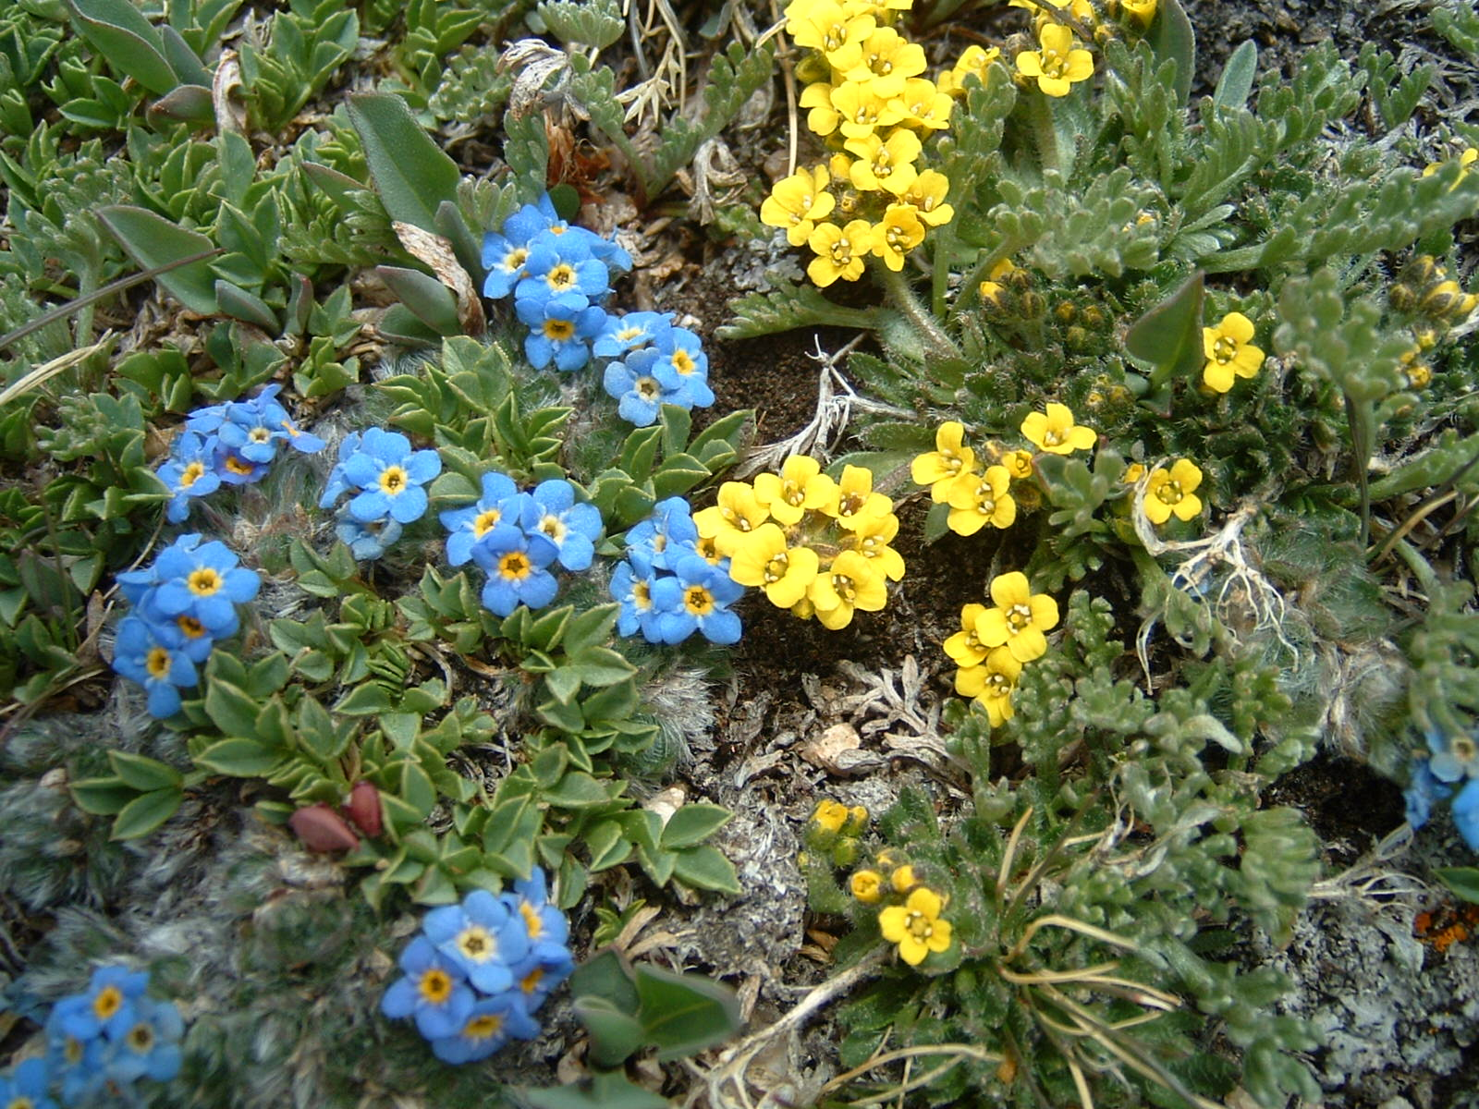
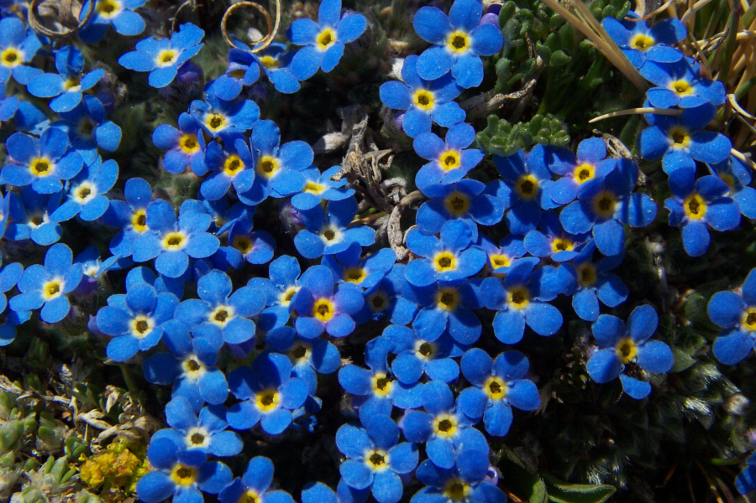
Notes:
While the hairs reflect visible light rays, they trap heat rays, warming the surface of the plant in a greenhouse like effect. When the alpine forget-me-not is in bud, that bud looks like an elfin ear muff. Because of this furriness, the alpine forget-me-not is one of the earliest flowering plants at very high elevations.

Slide 18
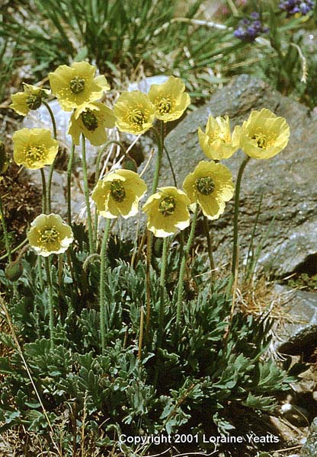
Alpine Poppy (Papaver kluanense)
Notes:
Some alpine plants like this alpine poppy (a tracked species) have dark hairs on their buds which absorb even more heat than white hairs, warming the developing flower within.

Slide 19
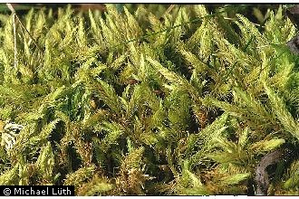
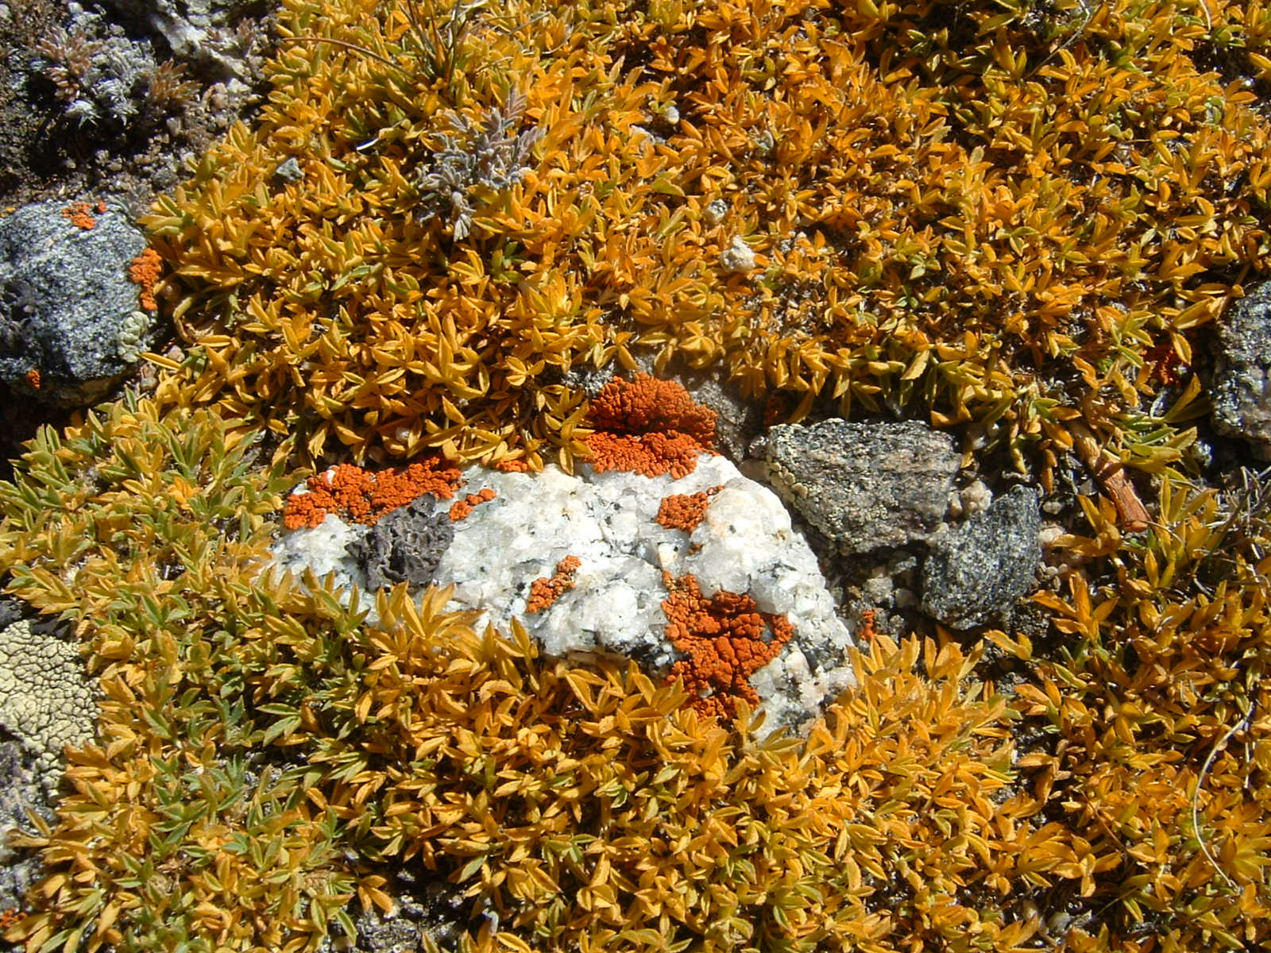
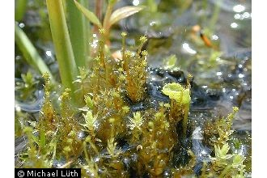
Nonflowering Plants
Lichens & Mosses
Notes:
Nonflowering Plants
Lichens, Mosses, and clubmosses. Minimal requirements for survival.
Lichens – formed from a fungus and an alga; fungus forms tough outer layers while the inner layers contain algal cells enmeshed in fungal threads.
Ability to absorb more than their own weight of water after a spell of dry weather.
Mosses too are spongelike. Mosses curl their leaves tightly against the stem when dry (like in the top picture), unfolding them to absorb moisture through the whole leaf surface during rain or heavy dew.
mosses are non-vascular plants that absorb water and nutrients mainly through their leaves and harvest carbon dioxide and sunlight to create food by photosynthesis. Mosses reproduce using spores, not seeds and have no flowers.

Slide 20
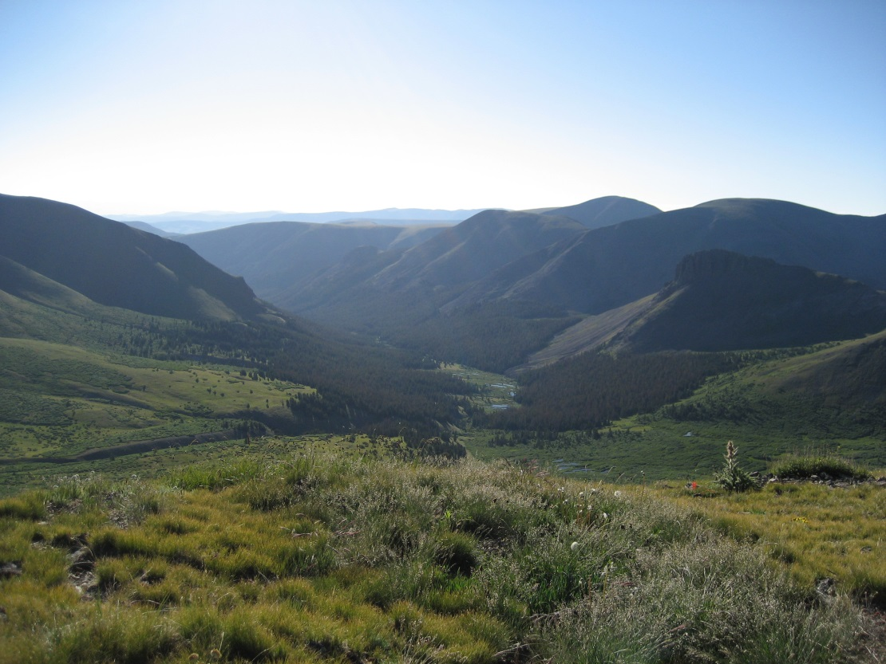
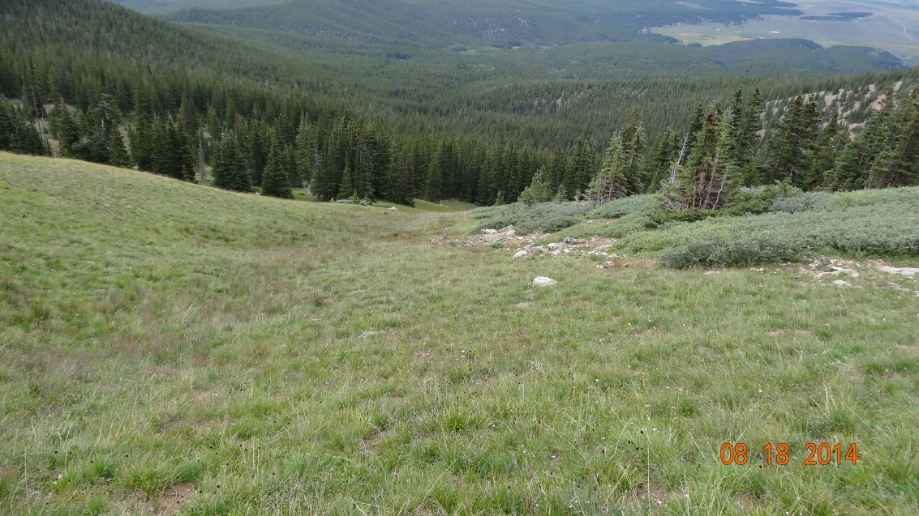
Grasses & Sedges
Narrow leaves
Simple flowers
Notes:
Grasses & Sedges
Grasses and sedges have narrow leaves and stems – not likely to be torn by alpine winds.
Flowers reduced to essentials – no bright petals or cupped sepals, just reproductive parts enclosed in a simple protective envelope.

Slide 21
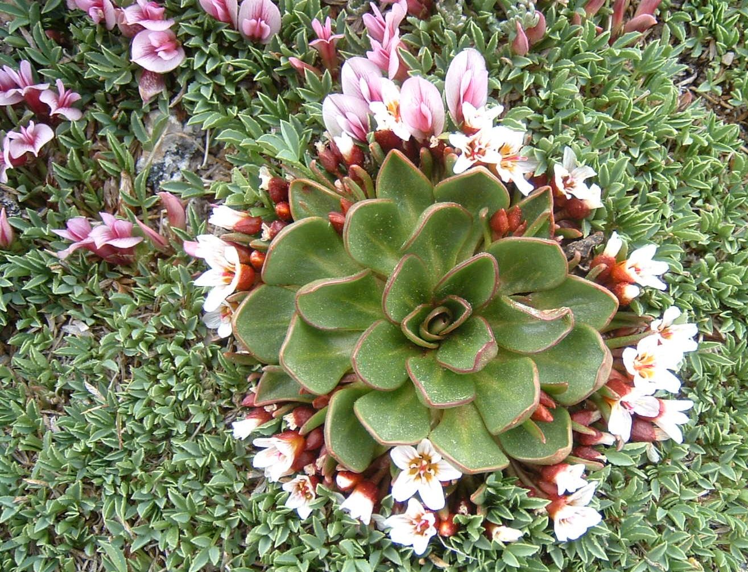
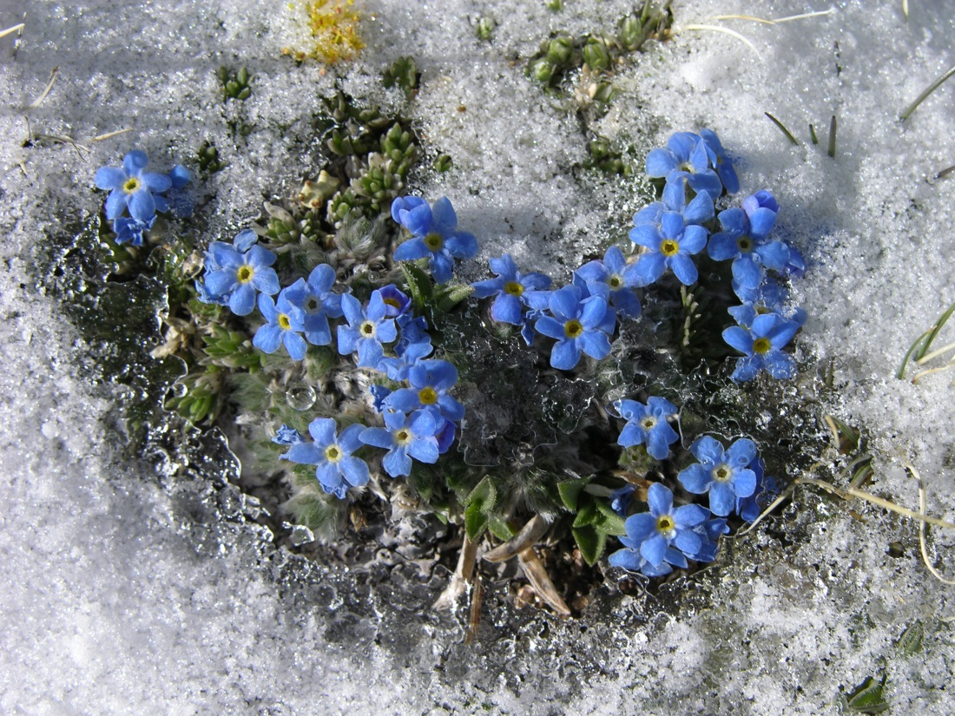
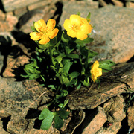
Mary Anne Tarr
Notes:
Okay, now I’m going to test you…Let’s name some Plant Adaptations
Review: Name the adaptations of these plants
1 – pubescence
2- leaf orientation (rosette form) & succulence
3 – chemical adaptations Anthocyanins
4 – Preformation of buds & radiant heating

Slide 22
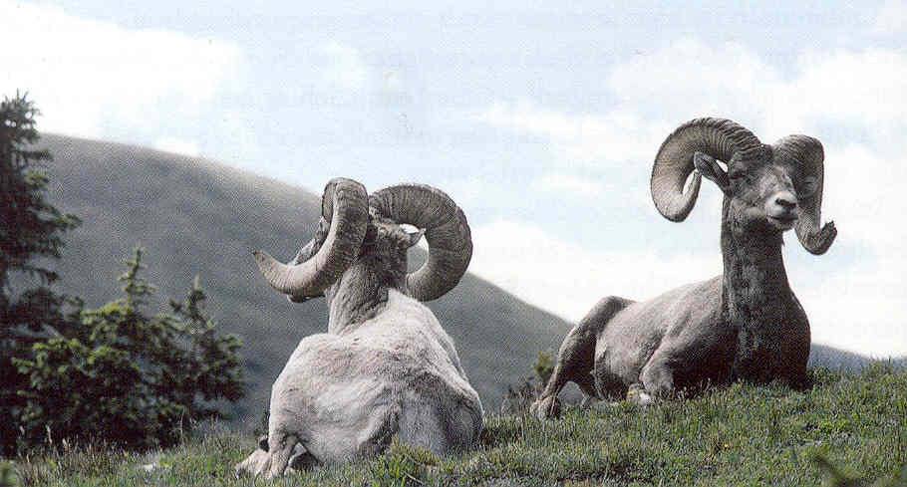
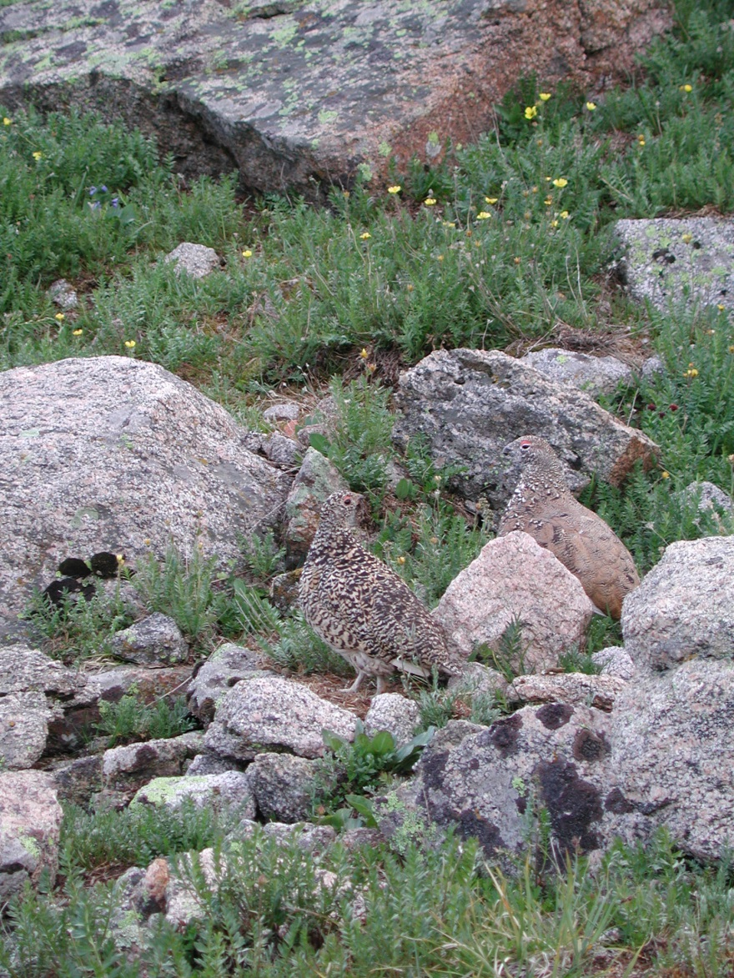
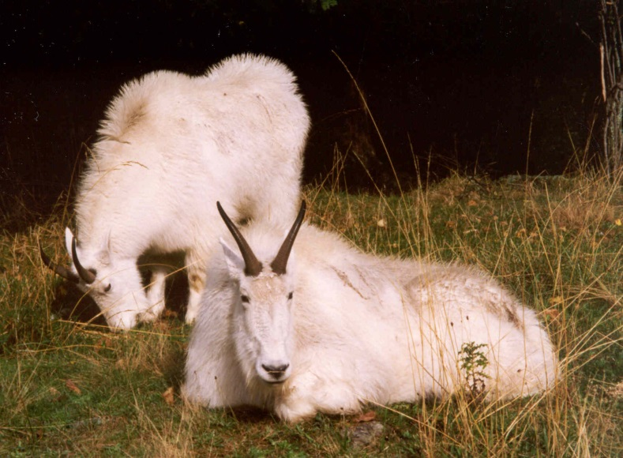
Alpine Fauna
Notes:
Alpine Fauna
Animals are also adapted to the harsh alpine climate.
Life cycles may be stretched over several seasons, larval stages being accomplished over several summers instead of a month
Litters or broods produced in summer is reduced, usually to one.
Maturation at a quickened rate.
Physiological adjustments may occur in metabolisms that make it possible to remain either part or all of the year in this rigorous environment.

Slide 23
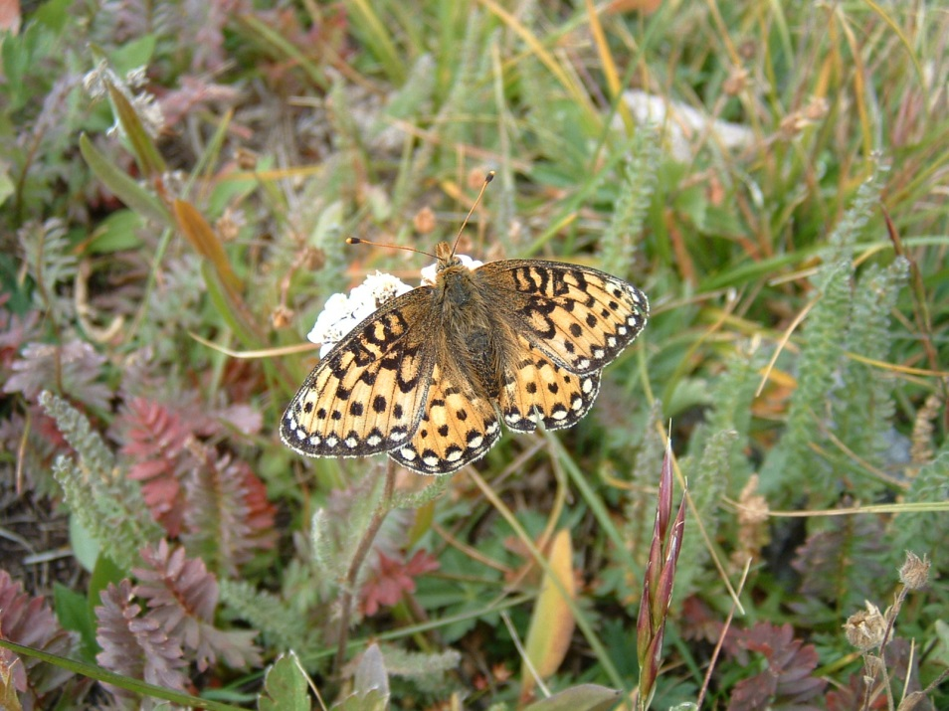
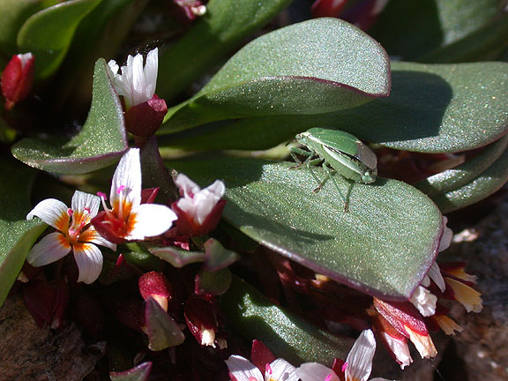
Insects
Notes:
Insects: Black flies, mosquitos, grasshoppers, ladybugs.
Insects are extremely important as pollinators on the tundra. Especially flies. At lower altitudes bees are the primary pollinators, but bees are immobilized at temperatures below 50 degrees F. With their lower energy requirements and ability to work under restricted condition, flies (and ants) assume considerable importance in the alpine region.
Reptiles & amphibians
Have any of you seen a reptile or amphibian in the alpine?
Why might that be?
The summer is so short and the temperatures stay cold enough so that no cold blooded reptiles or amphibians can usually live there. During the summer you may find a western terrestrial garter snake or tiger salamander. But that is very rare.

Slide 24
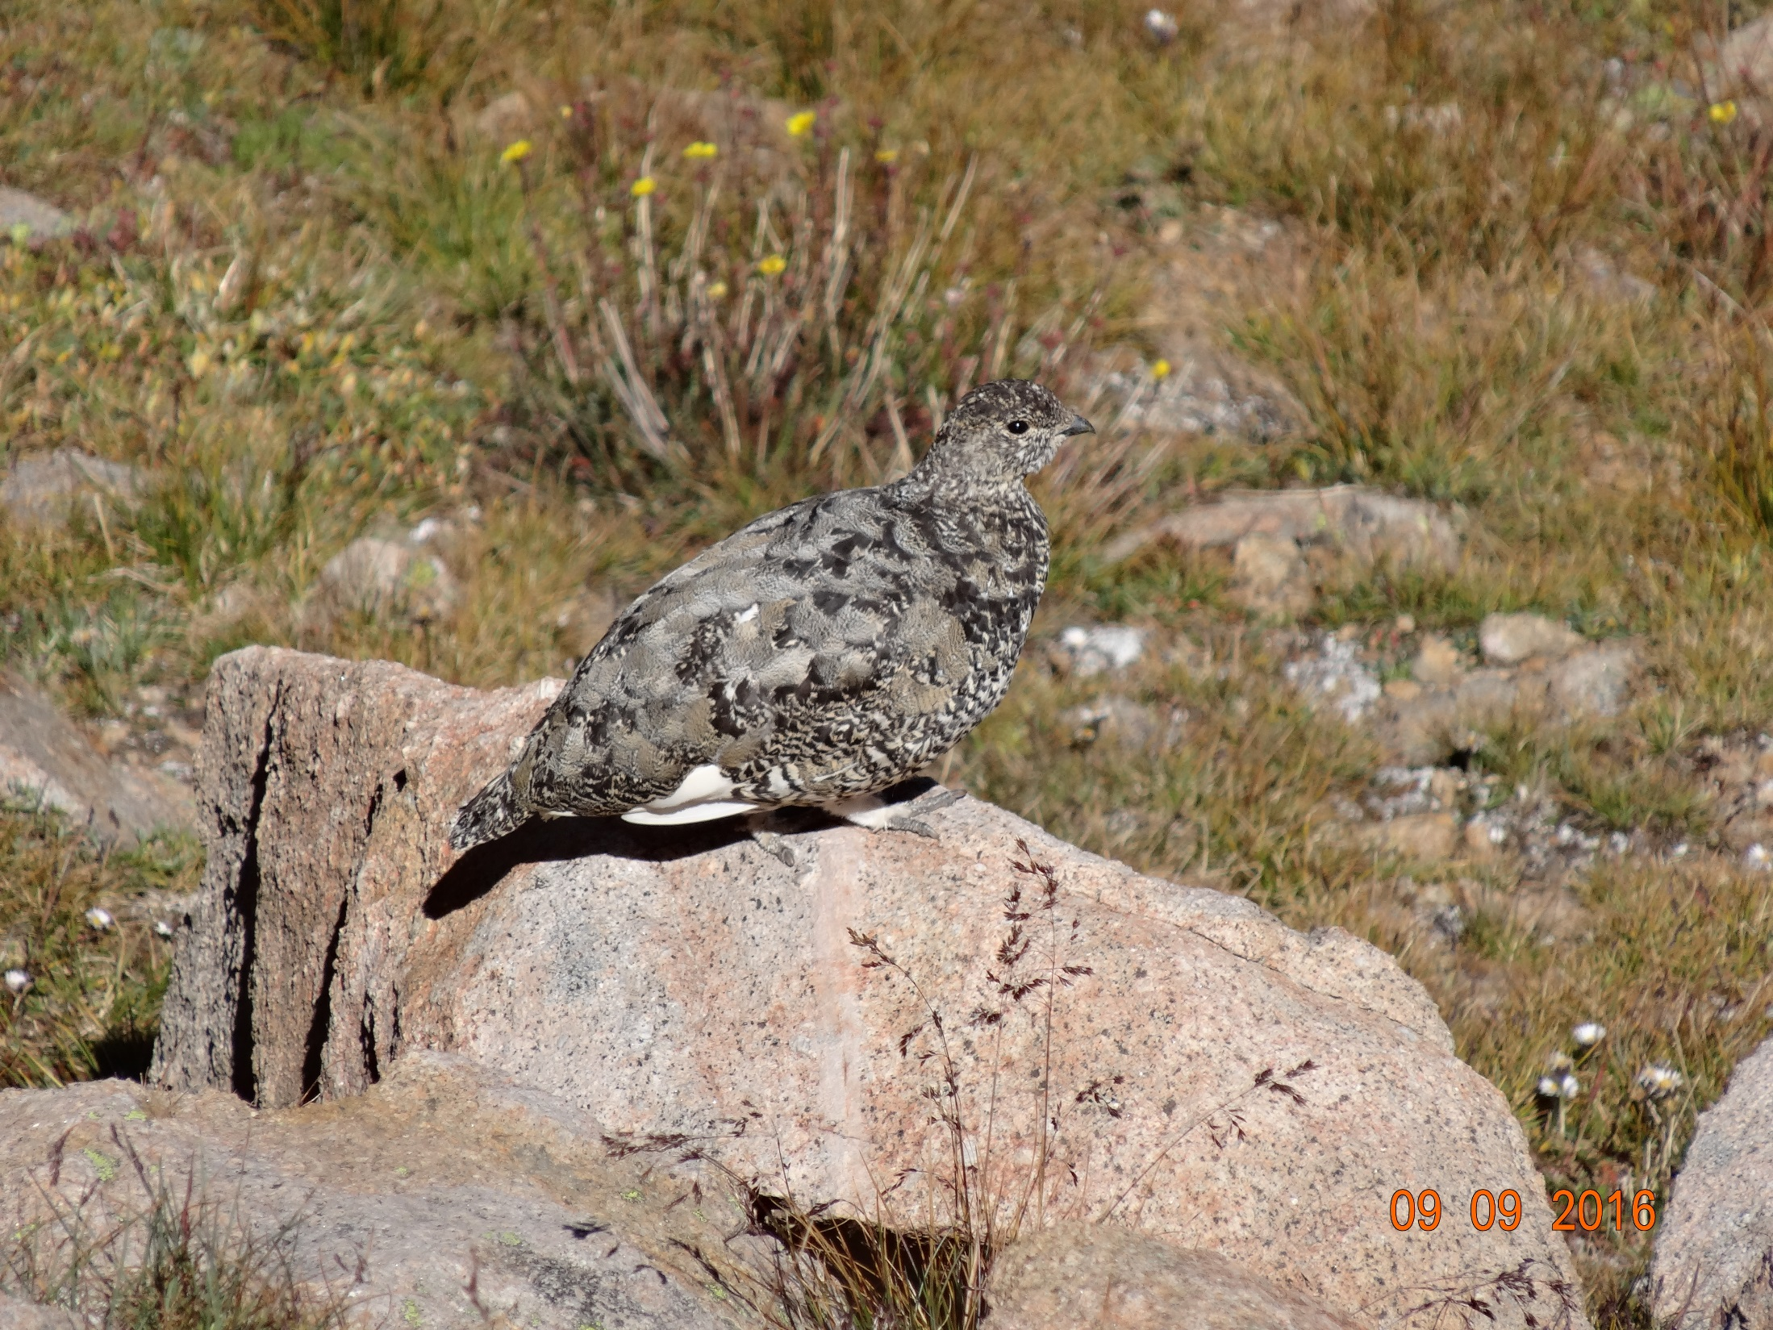
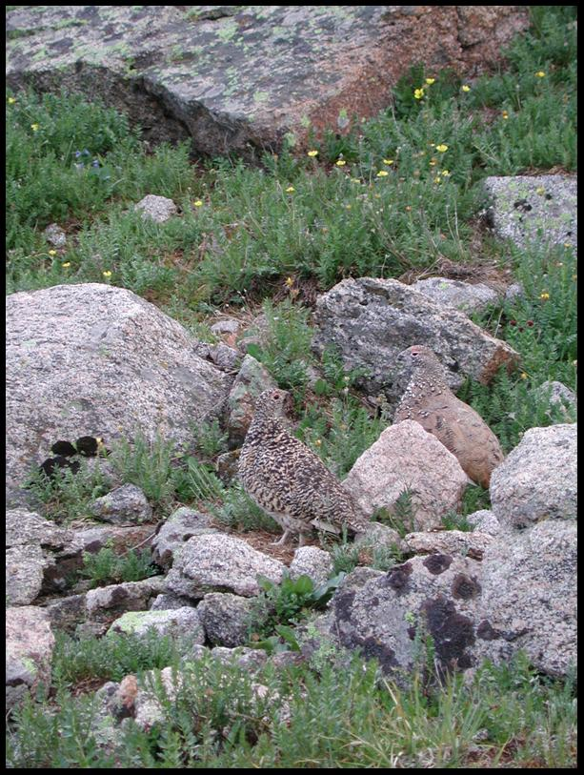
Birds
Notes:
Birds:
The number of birds on the alpine tundra is relatively small. Most birds live there only during the short alpine summer. The broad-tailed hummingbird drinks the nectar from the many flowers. The white-crowned sparrow and other small birds eat the seeds produced by the alpine plants and grasses. The wide open meadows make it easy for golden eagles to soar in the wind and hunt the animals during the short summer. The american dipper bobs in and out of the alpine streams hunting for insects and fresh water shrimp.
Does anyone know the name of this bird?
This is the ONLY bird that lives on the tundra all year.
It is a perfect example that demonstrates Bergmann’s Law:
Animals of cold climates tend to be larger, having a better ratio of volume to exposed area, making it easier to maintain body heat.
Adult ptarmigan sit out a storm in relative security, they typically nestled in the snow in a group, so individuals lose little of their body heat. In a tight circle, they expose even less surface in proportion to mass. In addition, ptarmigan’s legs and feet are so heavily feathered in the winter that they look like they are wearing pantaloons, giving both foot-warmth and snowshoes to cross the snow.

Slide 25
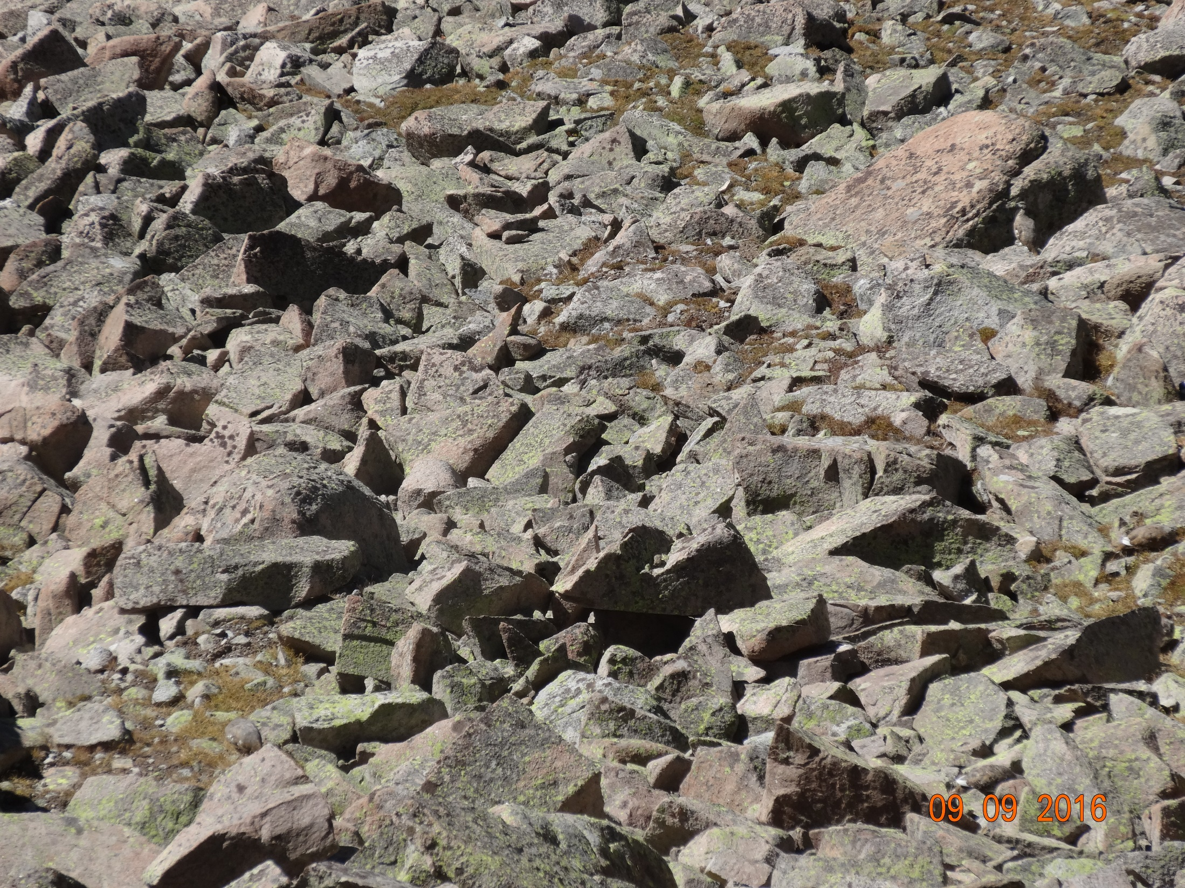
Notes:
How many Ptarmigan can you find?
There are at least 4.

Slide 26
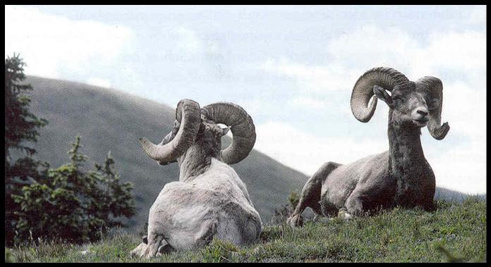
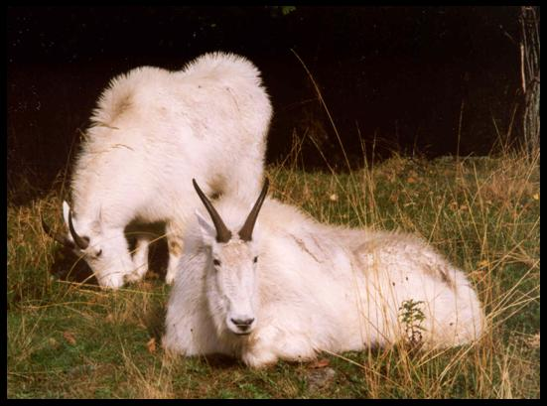
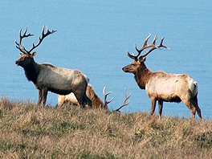
Large Mammals
Notes:
Large mammals:
Can you all identify these large mammals that are regulars on the alpine tundra?
Even these mammals will only remain above tree line in the winter if they are forced to. Grazing opportunities in winter are severely limited.
Elk – Bighorn Sheep – Mountain Goats

Slide 27
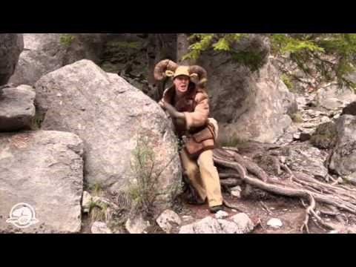
Goat or Sheep
Notes:
https://www.youtube.com/watch?v=hXoZioX_s1o

Slide 28
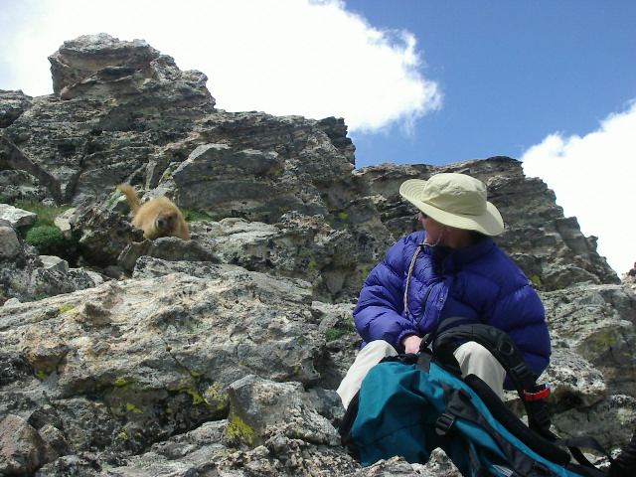
Small Mammals
Notes:
Small mammals:
There are significantly more small mammals that remain in the alpine year round. They survive the winter by storing food, hibernation, or incessant hunting.

Slide 29
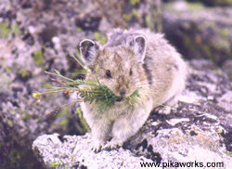
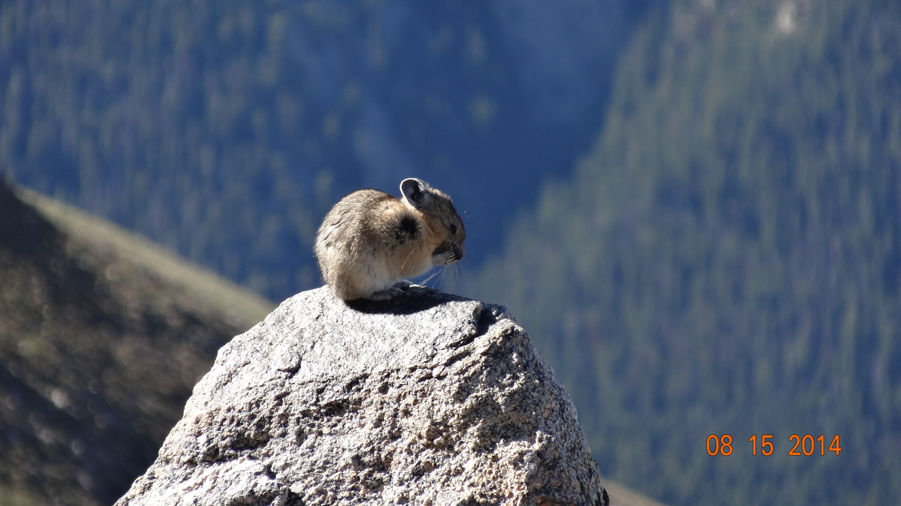
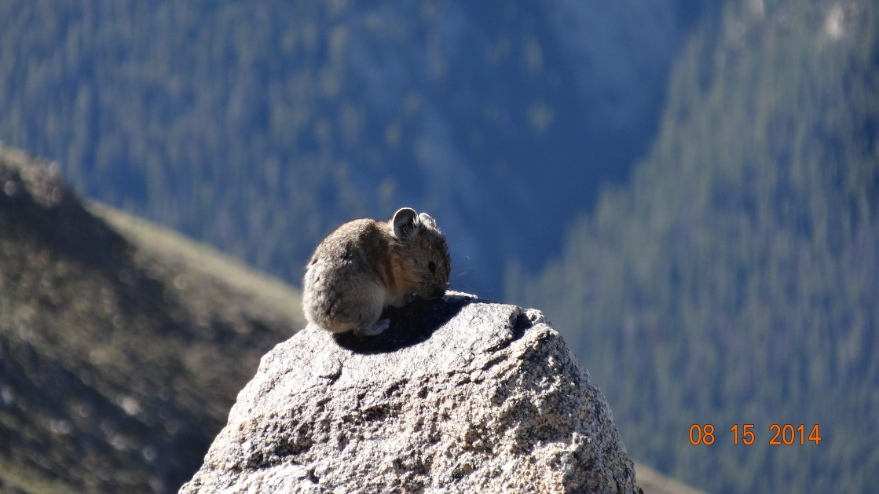
Notes:
What is the common name of this animal?
Can anyone tell me what family they are in?
Pika: pikas are small members of the rabbit family. Their ears have diminished in size to small round ones that are not as likely to freeze. Tails, ears and other extremities that are subject to rapid heat loss are often reduced or missing on animals in cold climates. In addition, they have fur on the soles of their feet, a nonskid device aiding their purchase on precipitous rock surfaces & helping to keep them warm.
Pika dens are often discovered by the Lilliputian stacks of hay at the doorstep. Pika begin preparing food for the winter by mid-July and continue until all available food is snowcovered.
Do you remember me talking about anthocyanins in plants? Well here is the continuation of that cycle. Pika gather inordinate amounts of alpine avens because those same anthocyanins help to prevent mold and bacterial growth in their food stores. Until the plants are dry, these anthocyanins are poisonous to the pika.
Pika’s vegetarian diet is not high in calories, and a pika must fill its stomach almost houly to meet its energy needs.
How many of you think the pika is cute?
Well, in order to obtain maximum food value, pika, like rabbits, are able to reingest fecal matter, which is high in protein content and energy value.
Pika also preserve body moisture in dry climates by depositing almost crystalline uric acids, leaving a white nitrogenous salt deposit on boulder surface.
Pika have been observed to be active during every month of the year and there is no evidence that they hibernate. They have to spend the months of July thru September storing enough food for nine or ten months.
Pika females will give birth to a litter in the spring. She will immediately get pregnant again and if that first litter does not survive (predation, cold, disease), she will deliver the second. If the first litter does survive, her body reabsorbs the fetuses.

Slide 30
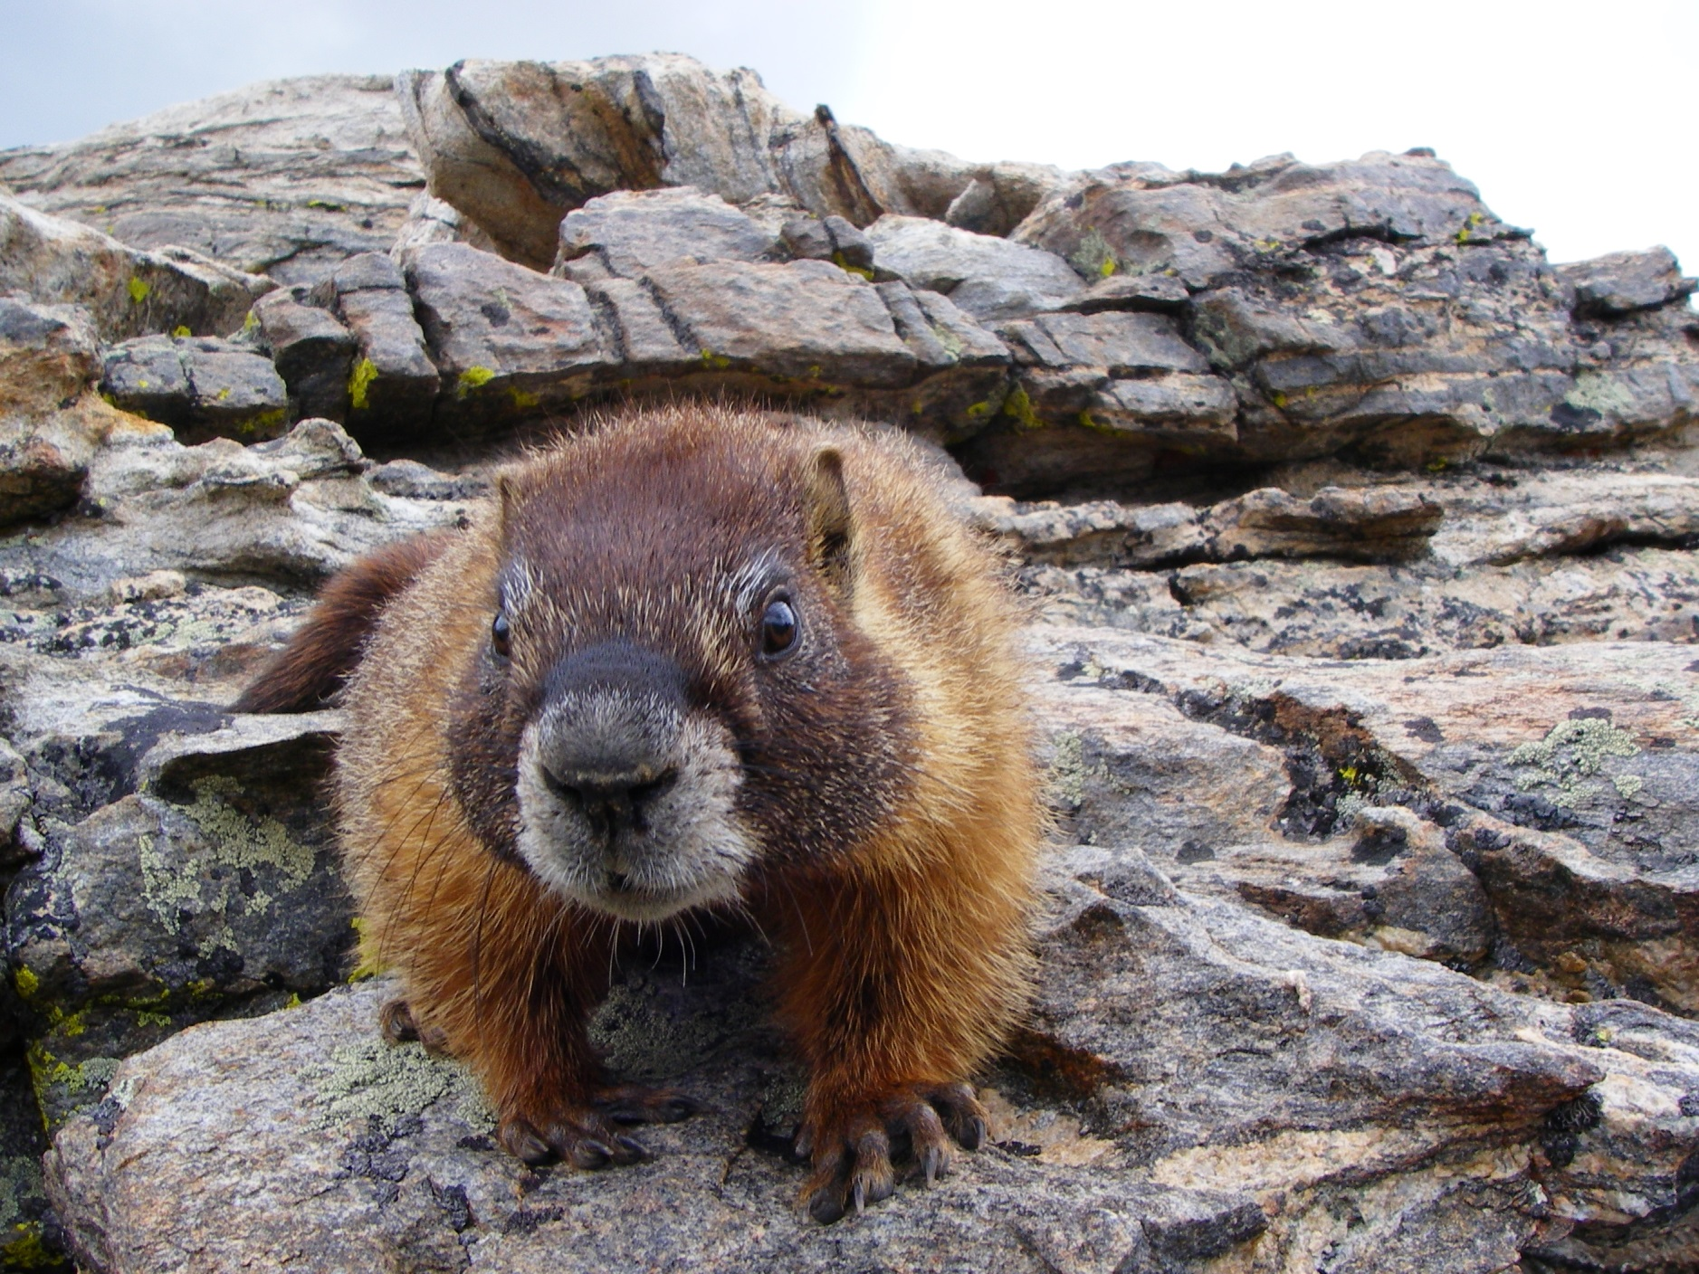
Notes:
Can everyone name this animal?
Marmots like ptarmigans are comparatively large animals. Relatives of woodchucks, marmots eat themselves FAT in the summer and hibernate all winter, body temperatures sinking almost to 32 degrees F. They emerge in late spring, sprawling on a warm rock surface in what seems to be blissful enjoyment of sunshine and warmth.

Slide 31
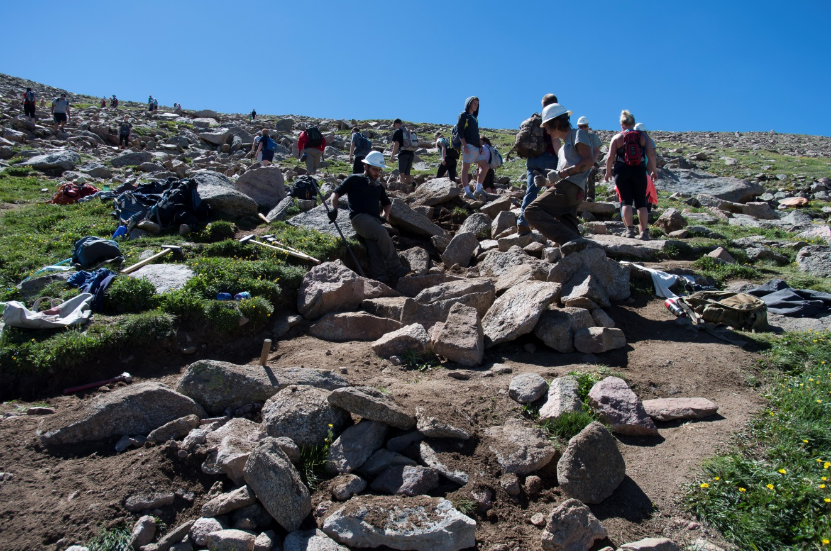
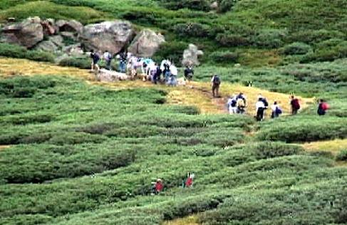
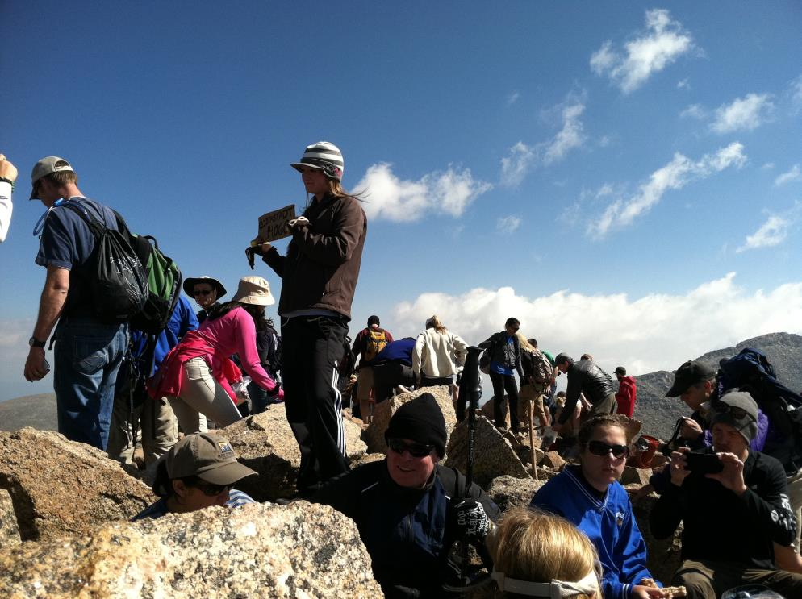
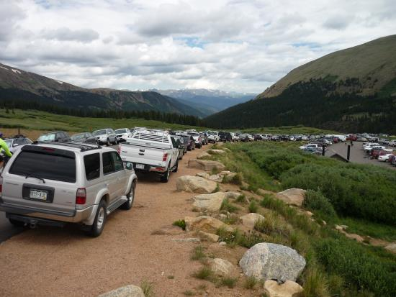
But the alpine has not adapted to this…..
Notes:
Although all these plants and animals have adapted well to their harsh environment, they have not adapted well to the presence of humans and especially the large numbers who seek out the 54 highest points in Colorado known as the Fourteeners.
This is why you receive this presentation. I don’t know how many times you have or will hear “the trail is slick, I’m just going to walk on the grass” Now you have the knowledge to explain, that it really isn’t just grass like we have in our neighborhood parks. These plants, insects, and animals live at the outer and upper extremes in the alpine environment because they have been rigorously selected and adapted to the harsh conditions that surround it. But they have not adapted to the presence of humans. As few as 5 footsteps in a single location is enough to kill the plants. Once the vegetation is destroyed, so is the alpine ecosystem. We need to recognize that we are visiting their home and take care not to destroy it.
Stay on the trails – the brown stuff….
Keep your distance from wildlife.
Keep your dogs on a leash.
Never feed the wildlife.
Keep your voice low so that others can experience the joys of nature.
Carry out your waste and your dog’s waste from the alpine environment, these plants and animals have enough to deal with.
And in the words of the Lorax “Unless someone like you cares a whole awful lot, Nothing is going to get better. It's not.”

